Slide 1


Academic Session 2025-26 ODD Semester JAN-JUNE 2026
UNIVERSITY INSTITUTE OF ENGINEERING COMPUTER SCIENCE AND ENGINEERING- AIT
Bachelor of Engineering
COMPUTER SCIENCE AND ENGINEERING (AIML)/ SEMESTER-IV
Introduction to Data Science
(SUBJECT CODE-24CST-281)
Chapter No. Lecture No. 1
Unit No.
Topic:
Faculty- Dr Ankit Kumar Dubey E Code-19315
Associate Professor

Slide 2
1
Vision of University
“To be globally recognized as a Centre of Excellence for Research, Innovation, Entrepreneurship and disseminating knowledge by providing inspirational learning to produce professional leaders for serving the society.”

Slide 3
2
Mission of University
M1 : Providing world class infrastructure, renowned academicians and ideal environment for Research, Innovation, Consultancy and Entrepreneurship relevant to the society.
M2 : Offering programs & courses in consonance with National policies for nation building and meeting global challenges.

Slide 4
3
Mission of University
M3 : Designing Curriculum to match International standards, needs of Industry, civil society and for inculcation of traits of Creative Thinking and Critical Analysis as well as Human and Ethical values.
M4 : Ensuring students delight by meeting their aspirations through blended learning, corporate mentoring, professional grooming, flexible curriculum and healthy atmosphere based on co-curricular and extra-curricular activities.

Slide 5
4
Mission of University
M5 : Creating a scientific, transparent and objective examination/evaluation system to ensure an ideal certification.
M6 : Establishing strategic relationships with leading National and International corporates and universities for academic as well as research collaborations.

Slide 6
5
Mission of University
M7: Contributing for creation of healthy, vibrant and sustainable society by involving in Institutional Social Responsibility (ISR) activities like rural development, welfare of senior citizens, women empowerment, community service, health and hygiene awareness and environmental protection.

Slide 7
6
Vision of Department
To be recognized as a leading department through effective teaching practices and excellence in research and innovation for creating competent professionals with ethics, values and entrepreneurial attitude to deliver service to society and to meet the current industry standards at the global level.

Slide 8
7
Mission of Department
M1 : To provide practical knowledge using state-of-the-art technological support for the experiential learning of our students.
M2 : To provide industry recommended curriculum and transparent assessment for quality learning experiences.
M3 : To create global linkages for interdisciplinary collaborative learning and research.

Slide 9
8
Program Educational Objectives (PEOs)
PEO 1: To produce xxx graduate engineers with an ability to comprehend, understand and analyze real life problems for providing sustainable solutions in the light of disruptive technologies.
PEO 2: To inculcate life-long learning skills in graduates preparing them for work in changing environments and multidisciplinary teams in order to enhance their capability being globally employable.

Slide 10
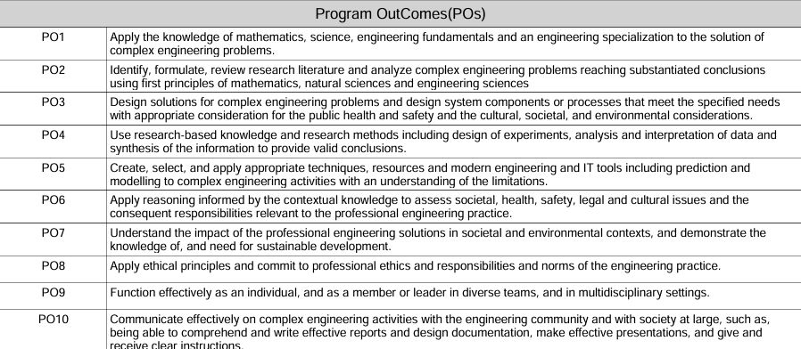
9
Program Outcome (POs)

Slide 11
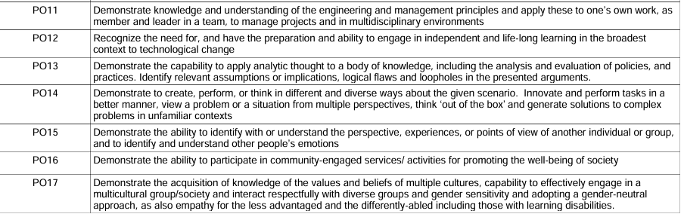
9
Program Outcome (POs)

Slide 12
10
Program Specific Outcome (PSOs)
PSO1 The graduating student will be able to apply computing and engineering principles to develop software solutions and innovative and interactive applications.
PSO2 The graduating student will be able to understand and learn with the contemporary trends in industrial settings and there by innovate novel solutions to existing problems.
PSO3 The graduating student will be able to design, implement and integrate engineering solutions with an understanding of professional, legal, managerial and financial issues

Slide 13
11
Date | Day | Activity | Category
05.01.2026 | Mon | Start of Even Semester - 2nd & 4th Year [All Programs] | Academics
06.01.2026 | Tue | Start of Even Semester - 1st, 3rd & 5th Year [All Programs] | Academics
10.01.2026 | Sat | Academic Day for Students of 1st, 3rd & 5th Year | Academics
12.01.2026 | Mon | Evoke: National Youth Summit | Co-Curr.
27.01.2026 | Tue | The Artist Achievers Awards | Co-Curr.
09.02.2026 | Mon | MST 01 [1st Hourly Test] [09.02 to 12.02] | Exams
13.02.2026 | Fri | Annual Athletic Meet [13.02 to 14.02] | Co-Curr.
06.03.2026 | Fri | Project Expo 2026 [06.03 to 07.03] | Academics
09.03.2026 | Mon | Practical MST [09.03 to 14.03] | Exams
13.03.2026 | Fri | Babasaheb Bhimrao Ambedkar National Youth Parliament | Co-Curr.
17.03.2026 | Tue | MST 02 [17.03 to 20.03] | Exams
25.03.2026 | Wed | CU Theatre Festival [25.03 to 27.03] | Co-Curr.
27.03.2026 | Fri | CU Fest - National Cultural Festival [27.03 to 28.03] | Co-Curr.
10.04.2026 | Fri | CU Heritage Festival | Co-Curr.
24.04.2026 | Fri | Last Teaching Day (Except UID) | Academics
25.04.2026 | Sat | End Sem Practical Exams + Project Evaluation [25.04 to 30.04] | Exams
01.05.2026 | Fri | Last Teaching Day (UID) | Academics
01.05.2026 | Fri | End Sem Theory Exams (Except UID) [01.05 to 23.05] | Exams
04.05.2026 | Mon | End Sem Practical Exams (UID) [04.05 to 09.05] | Exams
11.05.2026 | Mon | End Sem Theory Exams (UID) [11.05 to 23.05] | Exams
23.05.2026 | Sat | End of Even Semester | Academics
25.05.2026 | Mon | FDP/Conference/Workshop [25.05 to 29.05] | Faculty Dev.
01.06.2026 | Mon | Summer Term/Internships/Boot Camp [01.06 to 30.06] | Academics
01.06.2026 | Mon | Summer Break for Faculty [01.06 to 30.06] | Faculty
12.06.2026 | Fri | Announcement of Results | Exams
29.06.2026 | Mon | Graduation Ceremony for International Students | Academics
01.07.2026 | Wed | Summer Term + Special Reappear Exams [01.07 to 07.07] | Exams

Slide 14
15
Course Information
SN | 24CST-281 | Course Name: Introduction to Data Science | L | T | P | S | C | CH | Course Category | Course Type
4 |  | Course Coordinator: Dr. Ankit Kumar Dubey | 3 | 0 | 0 | 0 | 3 | 3 | PE-H | Theory
PRE-REQUISITE |  | Probability and Statistic
CO-REQUISITE |  | Nil
ANTI-REQUISITE |  | Nil
COURSE DESCRIPTION
Data science is the study of data to extract meaningful insights for business. It is a multidisciplinary approach that combines principles and practices from the fields of mathematics, statistics, artificial intelligence, and computer engineering to analyze large amounts of data. This analysis helps data scientists to ask and answer questions like what happened, why it happened, what will happen, and what can be done with the results.
COURSE OBJECTIVES:
To understand the overview and definition of Data Science with its crucial role in current business world.
To understand the importance of mathematics & Statistics in Data Science.
To understand the role of machine learning techniques in Data Science and its different types.
To know the integrated role of computers and its components in Data Science

Slide 15
16
Course Outcomes
Course Outcomes (COs)
On completion of this course, the students shall be able to:-
CO1: To understand the overview, definition, and role of Data Science in solving real-world problems.
CO2: To develop foundational knowledge in mathematics and statistics essential for data analysis.
CO3: To understand the role and types of machine learning techniques used in Data Science.
CO4: To familiarize students with computer systems, tools, and components used in Data Science workflows.
CO5: To enable students to apply machine learning techniques for data-driven decision-making.

Slide 16

17
Importance of Subject
Data science is important because it extracts actionable insights from vast amounts of data to improve decision-making, drive innovation, and solve complex problems across various sectors like business, healthcare, and technology. It enables companies to understand customers better, optimize operations, and predict future trends, while also helping researchers make evidence-based discoveries and government agencies address global challenges. Essentially, it transforms raw data into strategic advantages. .

Slide 17
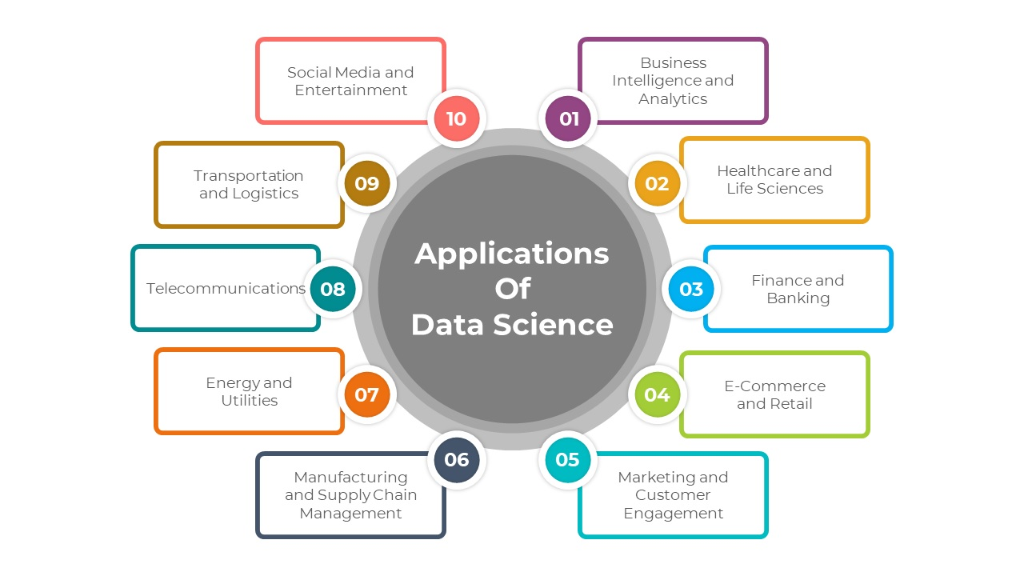
18
Applications of the Subject
Data science is applied across many sectors to analyze data, build predictive models, and find patterns for informed decision-making. Key applications include healthcare (diagnostics, personalized treatment), finance (fraud detection, risk management), e-commerce (recommendation systems, customer behavior prediction), transportation (route optimization, predictive maintenance), and marketing (targeted advertising, sentiment analysis). Other uses include natural language processing, image and speech recognition, gaming, and manufacturing optimization.
Figure-1 : Applications of Data Science

Slide 18
19
Syllabus (Theory)
Unit-1 | (Data Science - An Overview) | Contact Hours:15
Introduction | Introduction to Data Science, Definition and description, terminologies, Overview of Data Science techniques, challenges and opportunities in Data Science
Data Science and Business Analytics | Difference between Data Science and business analytics, importance of Data Science, primary components of Data Science, users of Data Science and its hierarchy
Linear Algebra for Data Science | Algebraic view - vectors, matrices, product of matrix & vector, rank, null space, solution of overdetermined set of equations and pseudo-inverse , Geometric view - vectors, distance, projections, eigenvalue decomposition
Unit-2 | (Mathematics and Statistics in Data Science) | Contact Hours:15
Mathematics in Data Science | Role of mathematics, importance of probability and statistics, important types of statistical measures: Descriptive, Predictive and prescriptive statistics, exploratory data analysis and visualization techniques, difference between exploratory and descriptive statistics
Statistics in Data Science | Statistical Modelling, descriptive statistics, notion of probability, distributions, mean, variance, covariance, covariance matrix, understanding univariate and multivariate normal distributions, introduction to hypothesis testing, confidence interval for estimates, Optimization for Data Science, Unconstrained Multivariate Optimization, Gradient ( Steepest ) Descent ( OR ) Learning Rule
Unit-3 | (Machine Learning in Data Science) | Contact Hours:15
Machine Learning | Role of machine learning, different types of machine learning techniques and its broad scope, Supervised, unsupervised, reinforcement and deep learning, difference between different machine learning techniques,
Classification and Prediction | Machine learning algorithms, importance of machine learning in today’s business, difference between classification and prediction.

Slide 19
20
MST Model QP
Subject Code: 24CST-281
Subject Title: Introduction to Data Science
Q1. Define Data Science. Explain its key components with suitable examples.
Q2. What do you mean by Data Science terminologies? Explain any four important DS terminologies.
Q3. Discuss the evolution of Data Science. How has the field transformed from traditional analytics to modern data-driven systems?
Q4. Explain any four major Data Science techniques with real-world applications.
Q5. Describe the major challenges faced in Data Science and suggest possible solutions.

Slide 20
22
EST Model QP
Q1. Define Data Science. Explain its key components with suitable examples.
Q2. What do you mean by Data Science terminologies? Explain any four important DS terminologies.
Q3. Discuss the evolution of Data Science. How has the field transformed from traditional analytics to modern data-driven systems?
Q4. Explain any four major Data Science techniques with real-world applications.
Q5. Describe the major challenges faced in Data Science and suggest possible solutions.
Q6. Differentiate between Data Science and Business Analytics with examples.
Q7. Explain the primary users and roles involved in a Data Science project lifecycle.
Q8. What is the importance of Data Science in today’s industry? Support your answer with examples.
Q9. Write short notes on the following (any two):
a) Opportunities in Data Science b) Components of a Data Science system c) Roles of Data Scientist and Data Engineer
Q10. Explain vectors and matrices with their relevance in Data Science applications.

Slide 21
23
Text and Reference Books
TEXTBOOKS/REFERENCEBOOKS
TEXTBOOKS
T1 Data Science from Scratch: First Principles with Python 1st Edition by Joel Grus
T2Principles of Data Science by SinanOzdemir, (2016) PACKT.
REFERENCE BOOKS:
R1. Data Science For Dummies by Lillian Pierson (2015)
R2. Data Science for Business: What You Need to Know about Data Mining and Data-Analytic Thinking by Foster Provost, Tom Fawcett
R3. Data Smart: Using Data Science to Transform Information into Insight 1st Edition by John W. Foreman. (2015) Wiley Publication

Slide 22
24
E-Learning links
Data Science for Engineers” — https://nptel.ac.in/courses/106106179
“Python for Data Science” — https://onlinecourses.nptel.ac.in/noc22_{c} s32/preview
“Data Analytics with Python”— https://onlinecourses.nptel.ac.in/noc25_{c} s17/preview

Slide 23
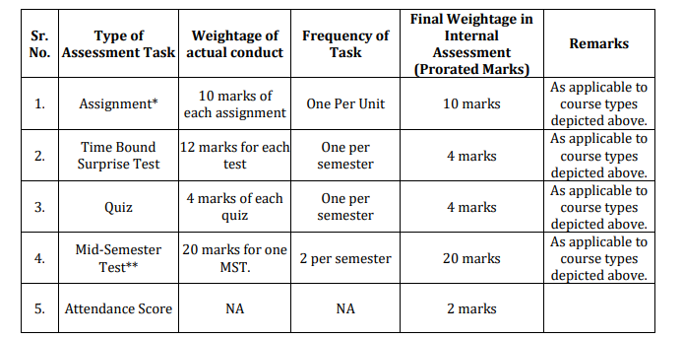
26
Assessment Model

Slide 24
27
Thank You
For queries
ankit.e19315@cumail.in

